Slide 1
Amazon Fresh Analytics
Pushparaj m - BADM-WD-T-B9

Slide 2
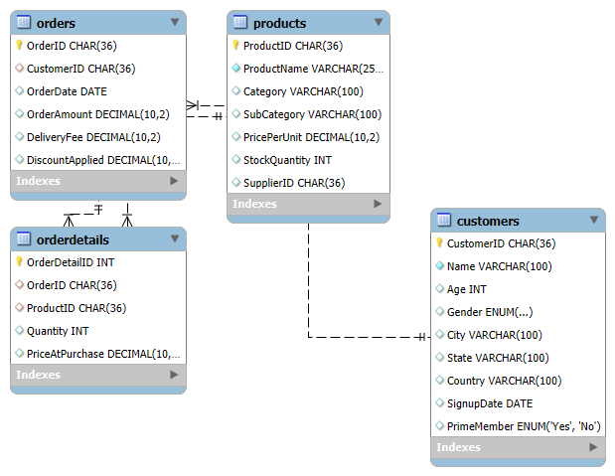
Data Modeling and Basic Queries Task 1: create an ER diagram for the amazon fresh database to understand the relationships between tables (e.g., Customers, products, orders).
Result

Slide 3
Task 2: identify the primary keys and foreign keys for each table and describe their relationships.
Here are the primary keys (PK) and Foreign Keys (FK) for each table, along with their relationships.
1.Customers Table:
Primary key : customer ID
Relationships:
One customer can place multiple orders
Customer ID in the orders table is a foreign key referring to customer ID in customers.

Slide 4
2.Products Table:
Primary key: Product ID
Relationships:
A product can be part of multiple orders.
Product ID in order detail is a foreign key referring to product ID in products.
3.Orders Table:
Primary key: Order ID
Foreign Key: Customer ID (References customers. customer Id)
Relationships:
Each order belongs to one customer.
Each order can contain multiple products (through order details).

Slide 5
4.Order Details Table (Many –to-Many relationship between orders and products):
Primary key: Order Detail ID
Foreign Key:
Order ID (References orders. orders Id)
Product ID (Reference Products. Products ID)
Relationships:
Connects orders and products , allowing multiple products in one order.
Entity Relationships :
1.One-to-Many (Customer - Orders)
A customer can place multiple orders, but each order belongs to one customer.
2.Many-to-Many (Orders - products via order details)
Each order can contain multiple products, and each product can be part of multiple orders.

Slide 6
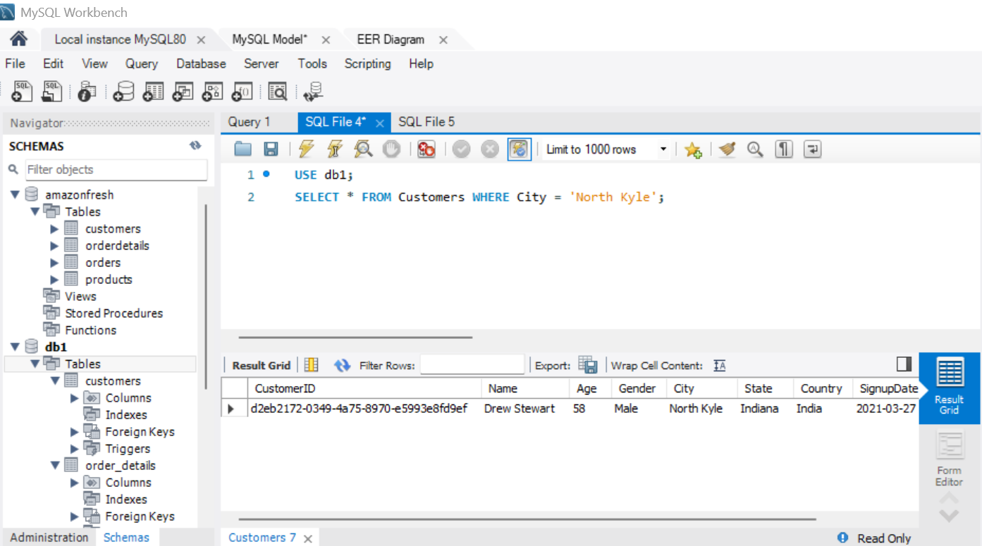
Task 3: Write a query to 1.Retrieve all customers from a specific city.
Result

Slide 7
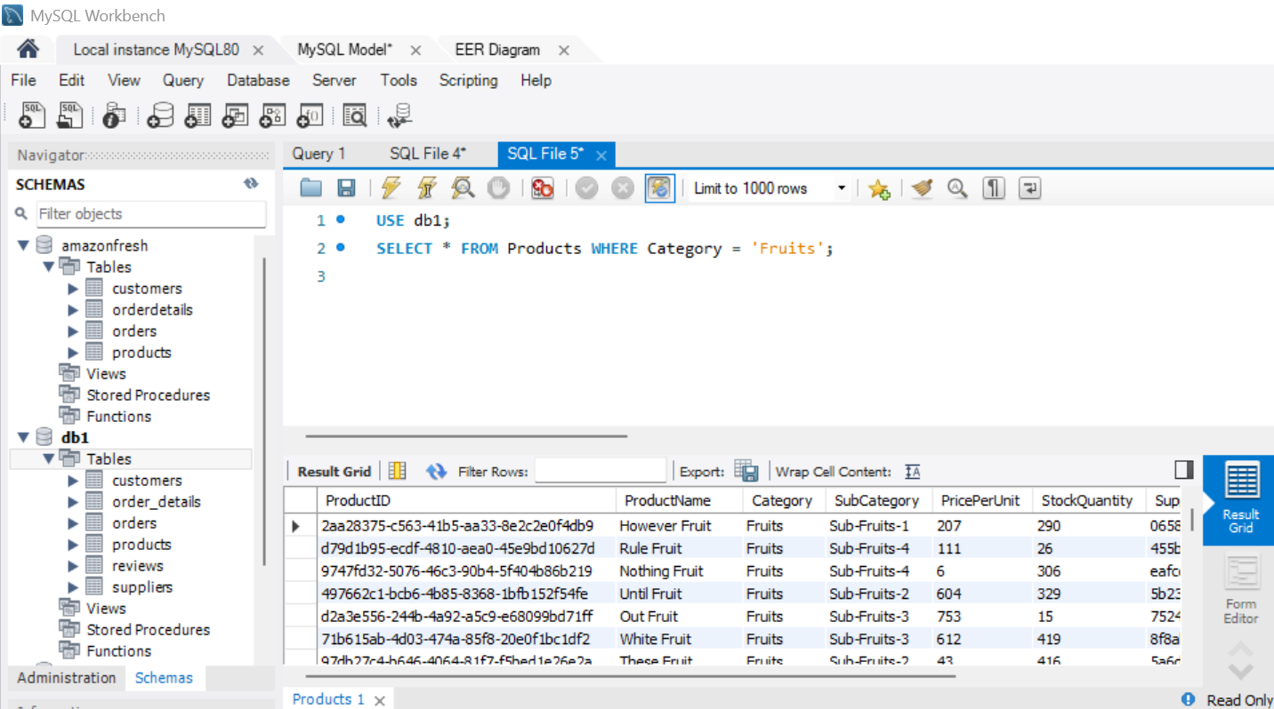
2.Fetch all products under the "fruits" category. Result

Slide 8
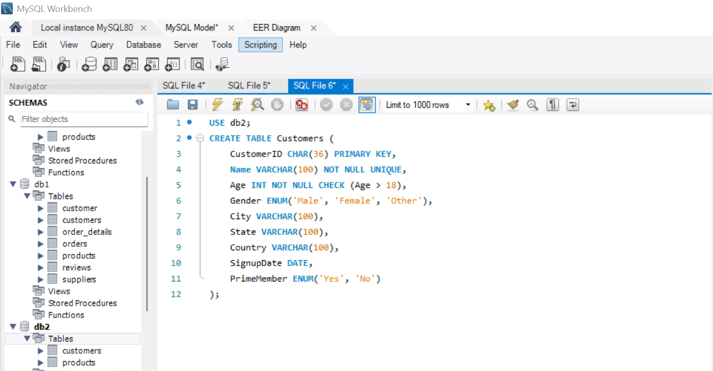
Data Definition Language (DDL) and Constraints Task 4: write DDL statements to recreate the customers table with the following constraints:
Customer Id as the primary key Result

Slide 9
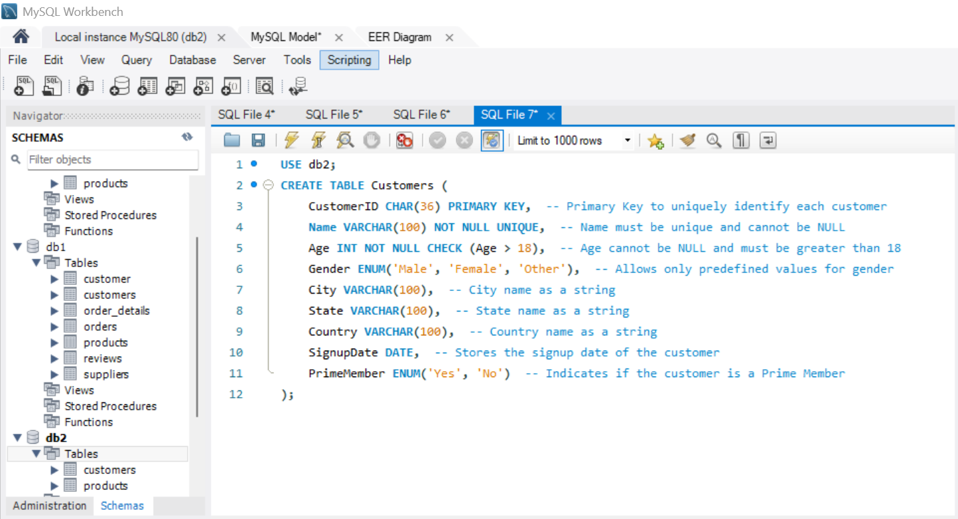
Ensure age cannot be null and must be greater than 18
Result

Slide 10
Add a unique constraint for name
Result
Constraints applied:
1. Primary key: customer ID is the primary key.
2. Age constraint:
NOT NULL ensures age cannot be empty.
Check (age>18) ensures only customers older than 18 can be inserted.
3. Unique constraint: name must be unique (UNIQUE)

Slide 11
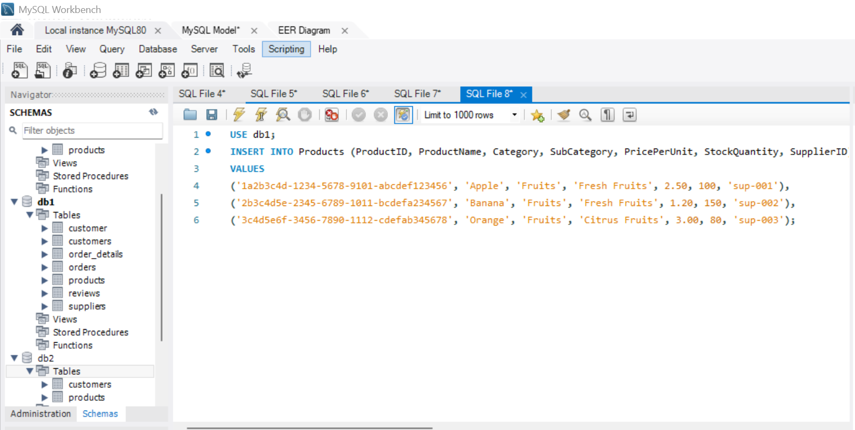
Data Manipulation Language (DML) Task 5: insert 3 new rows into the products table using INSERT statements
Result

Slide 12
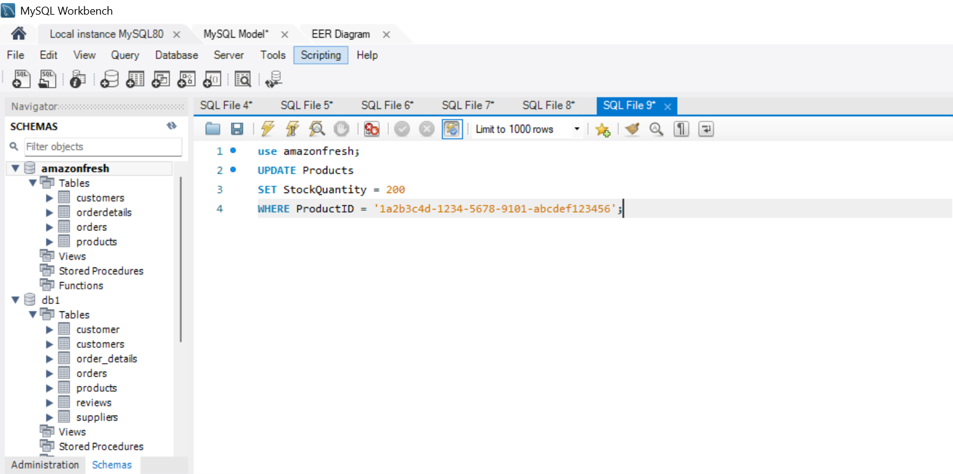
Task 6: update the stock quantity of a product where product Id matches a specific ID
Result

Slide 13
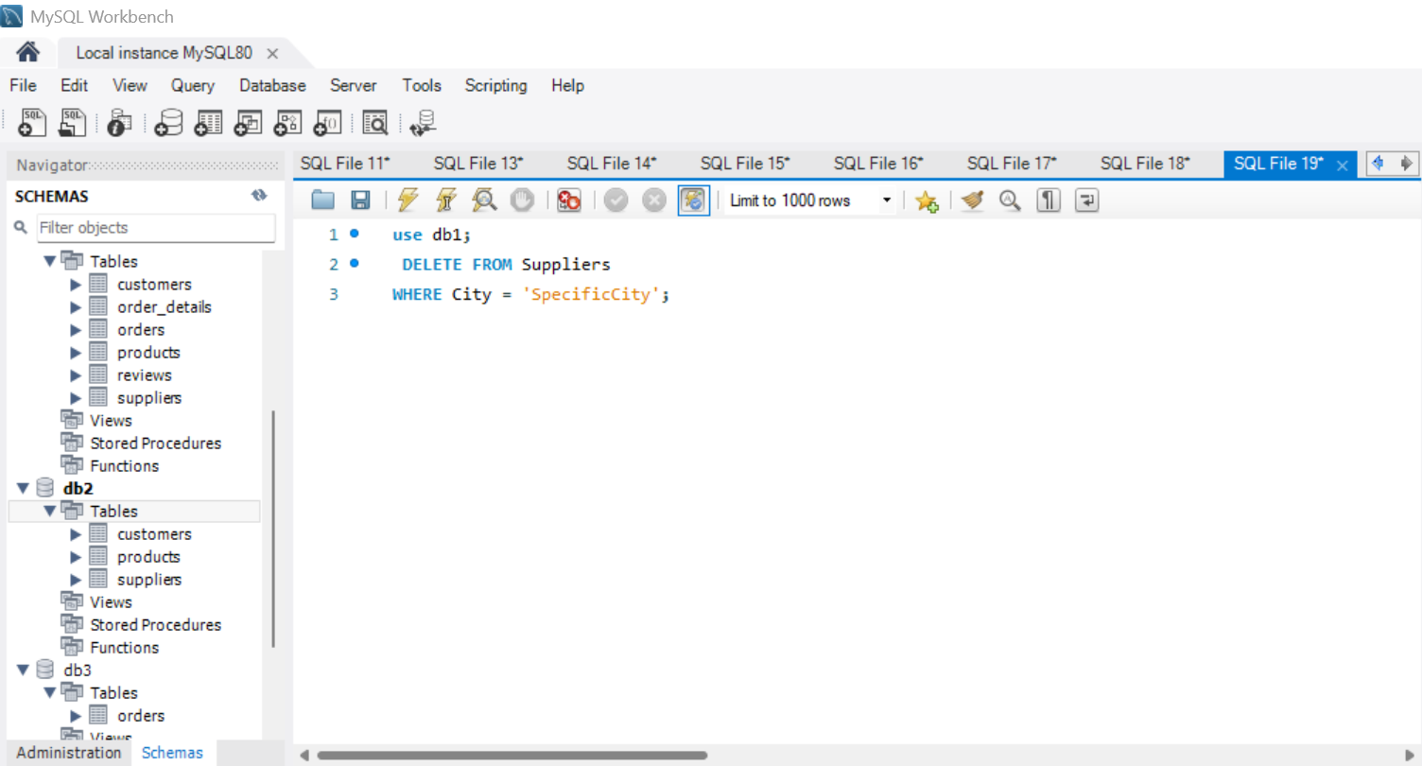
Task 7: delete a supplier from the suppliers table where their city matches a specific value
Result

Slide 14
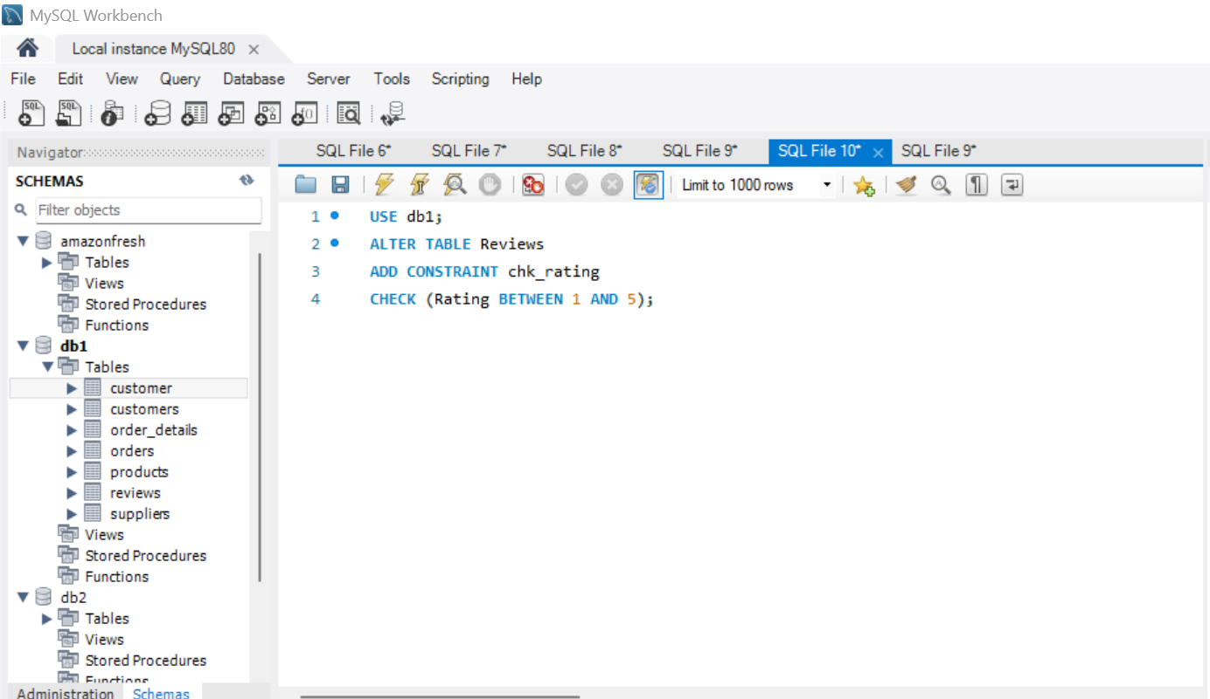
SQL Constraints and Operators Task 8: use SQL constraints to
Add a Check constraint to ensure that ratings in the reviews table are between 1 and 5.
Result

Slide 15
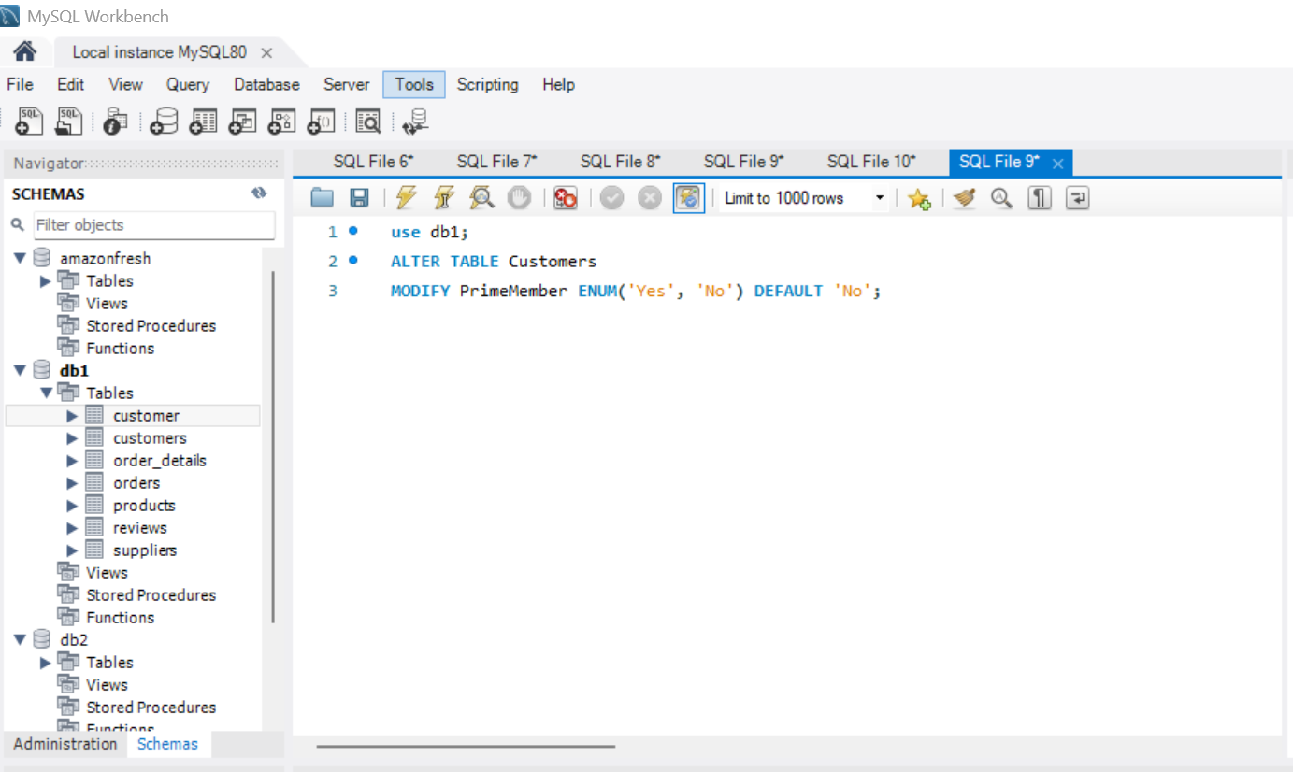
Add a DEFAULT constraint for the prime member column in the customers table (default value: "no")
Result

Slide 16
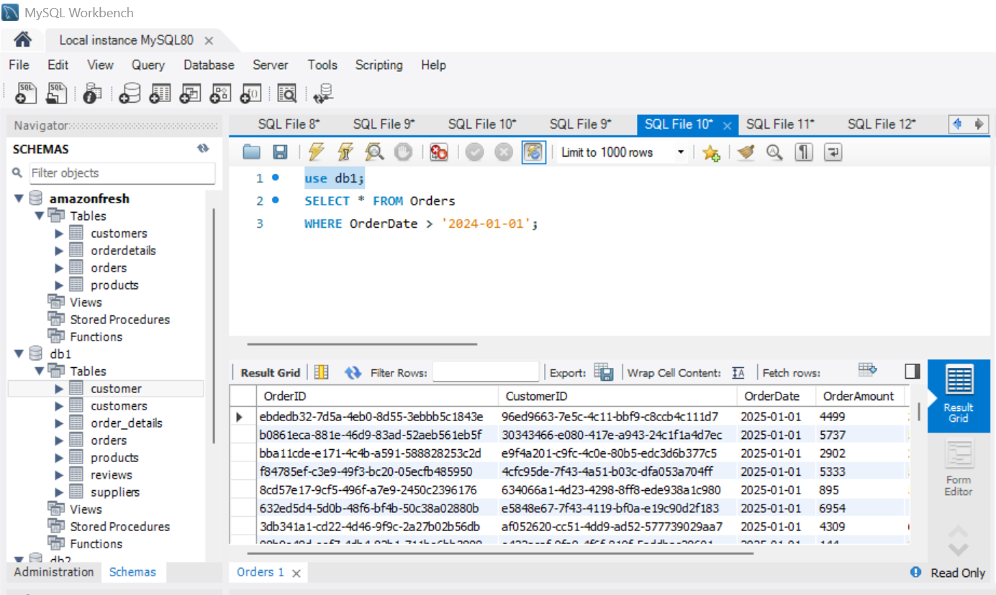
Clauses and Aggregations Task 9: write queries using
WHERE clause to find orders placed after 2024-01-01
Result

Slide 17
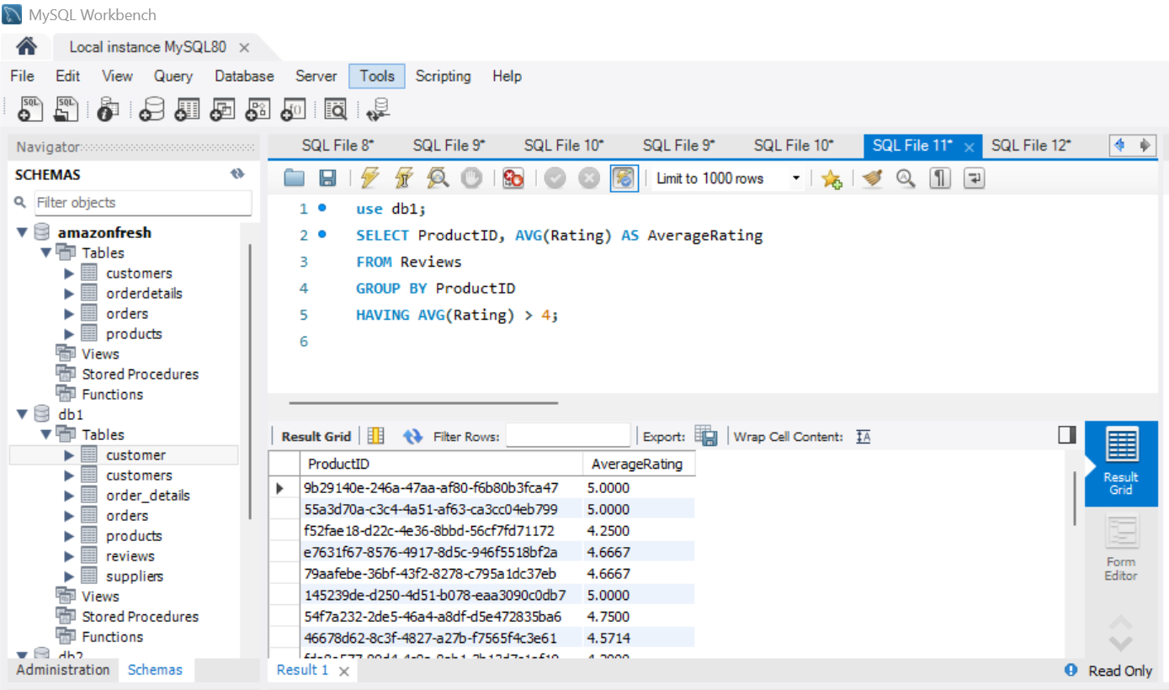
HAVING clause to list products with average ratings greater than 4
Result

Slide 18
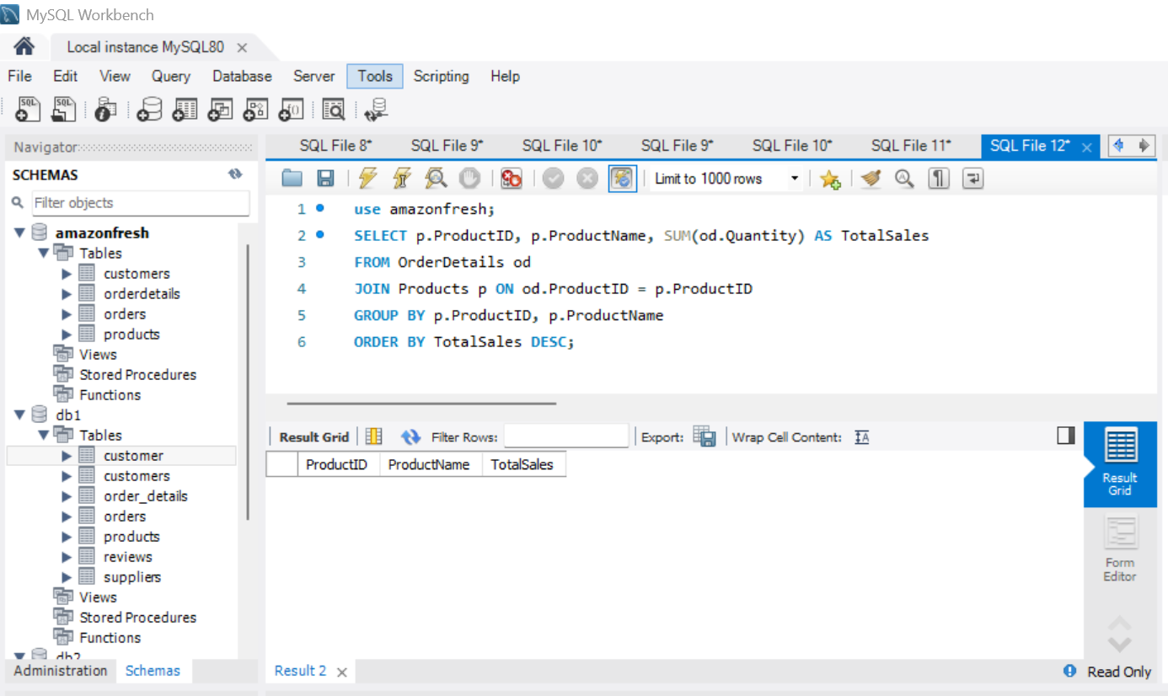
GROUP BY and ORDER BY clauses to rank products by total sales
Result

Slide 19
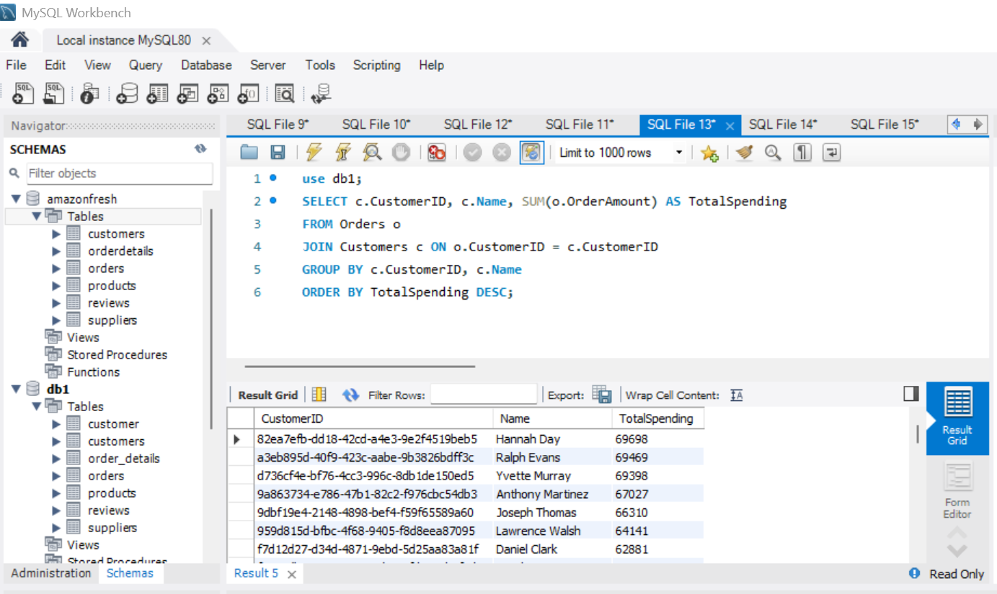
Task 10: identifying high-value customers Amazon fresh wants to identify top customers based on their total spending. We will
Calculate each customer's total spending.
Result

Slide 20
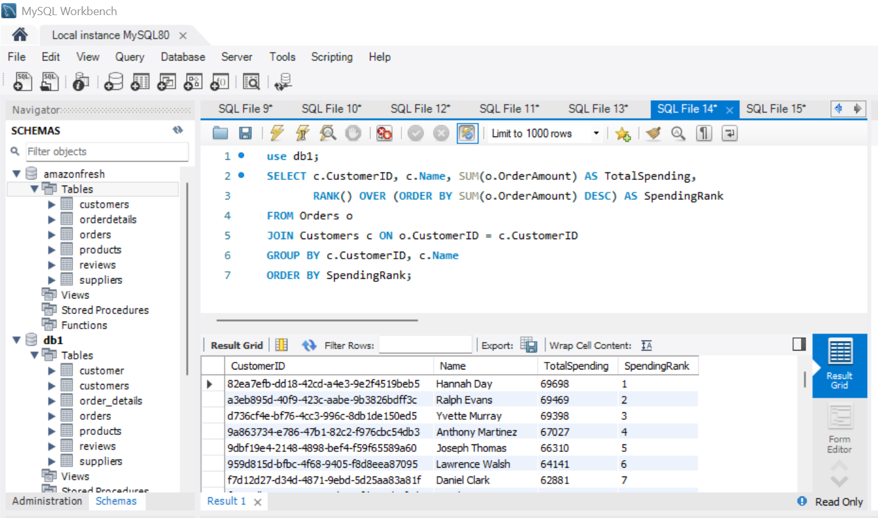
2. Rank customers based on their spending.
Result

Slide 21
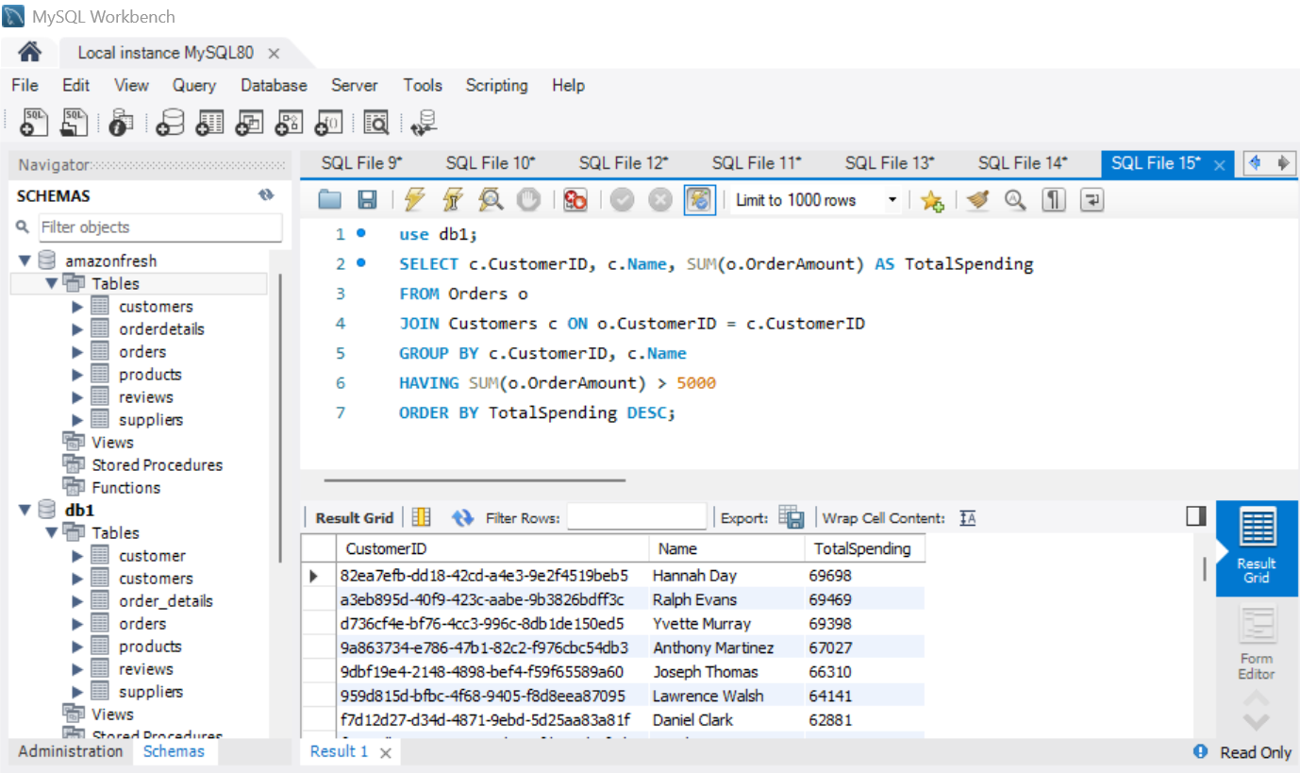
3. Identify customers who have spent more than ₹5,000
Result

Slide 22
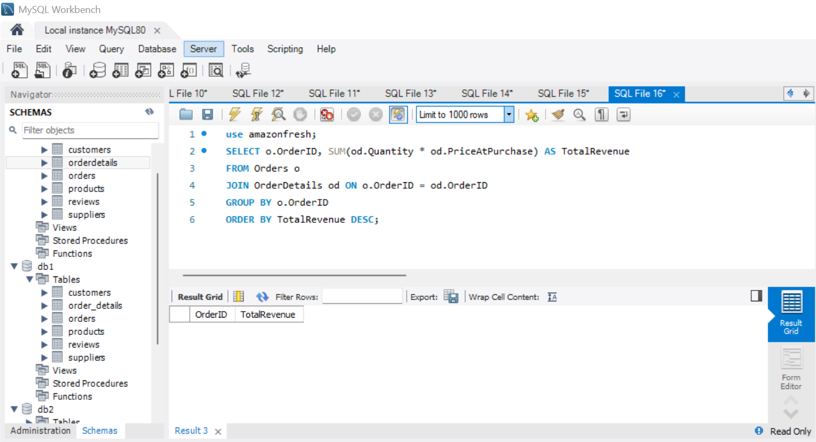
Complex Aggregations and Joins Task 11: use SQL to 1. Join the orders and order details tables to calculate total revenue per order
Result

Slide 23
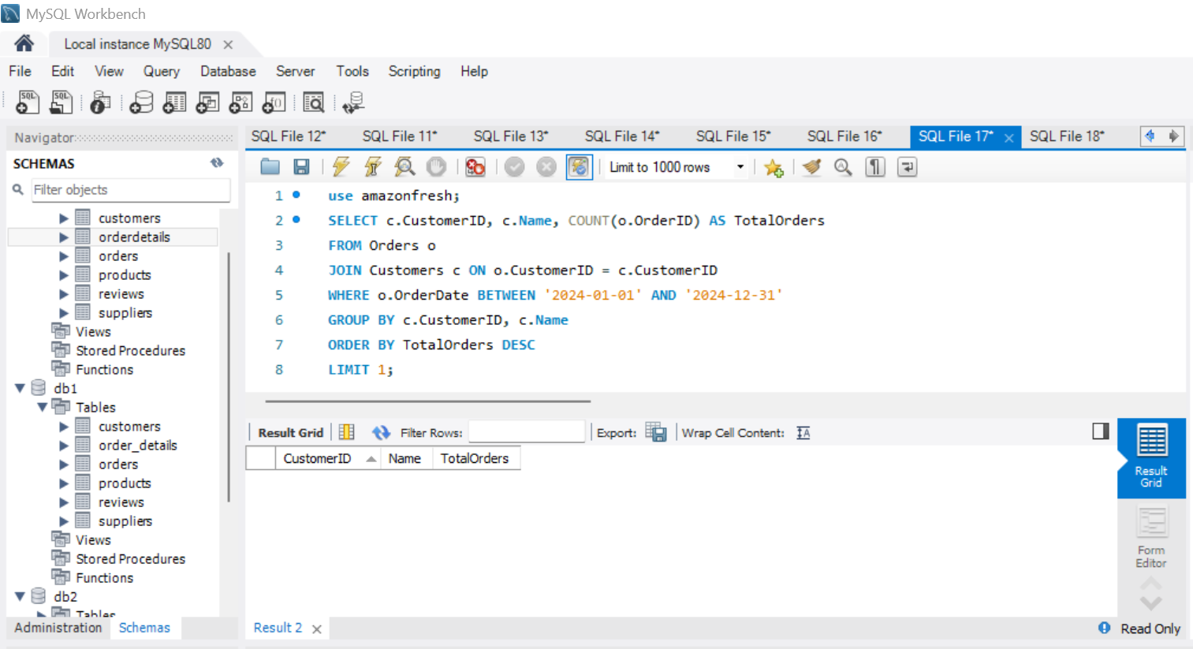
2. Identify customers who placed the most orders in a specific time period
Result

Slide 24
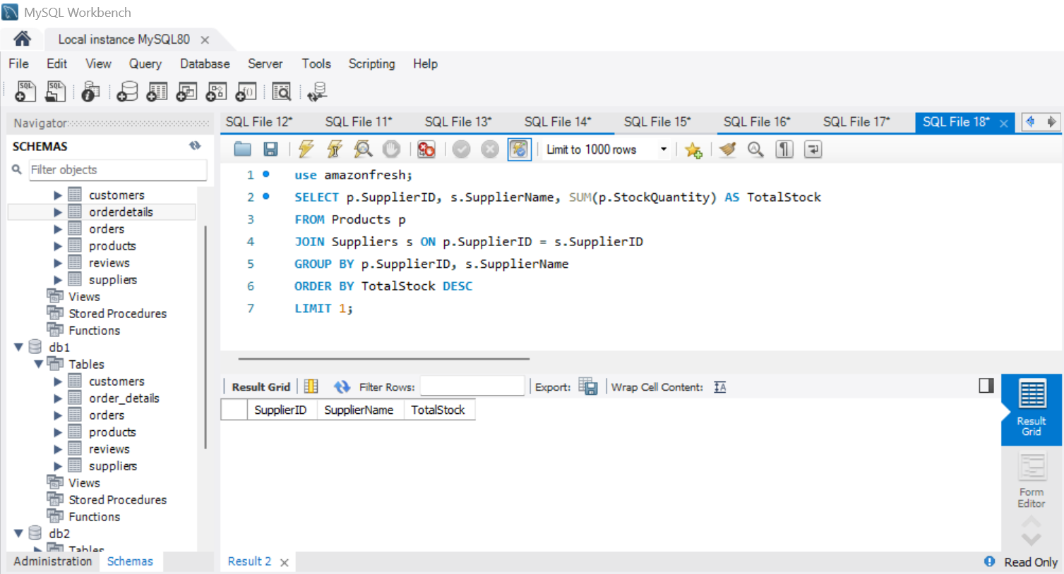
3. Find the supplier with the most products in stock
Result

Slide 25
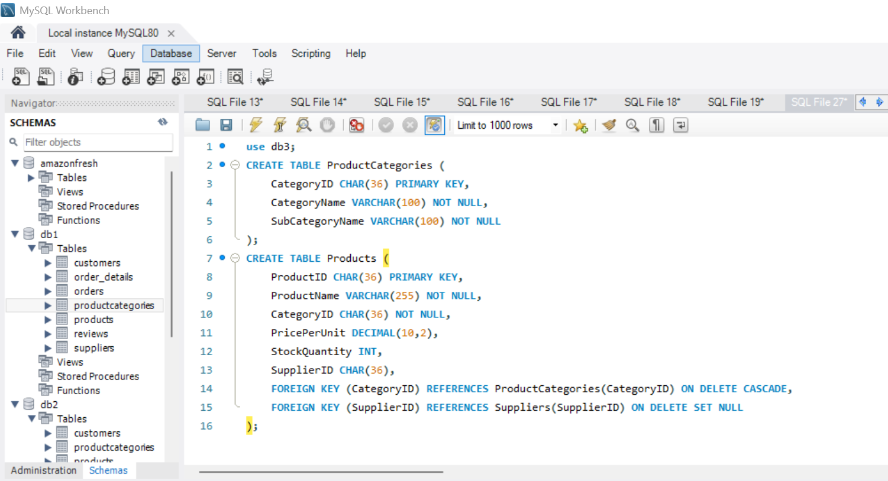
Normalization Task 12: normalize the products table to 3NF: 1.separate product categories and subcategories into a new table 2.Create foreign keys to maintain relationships.
Result

Slide 26
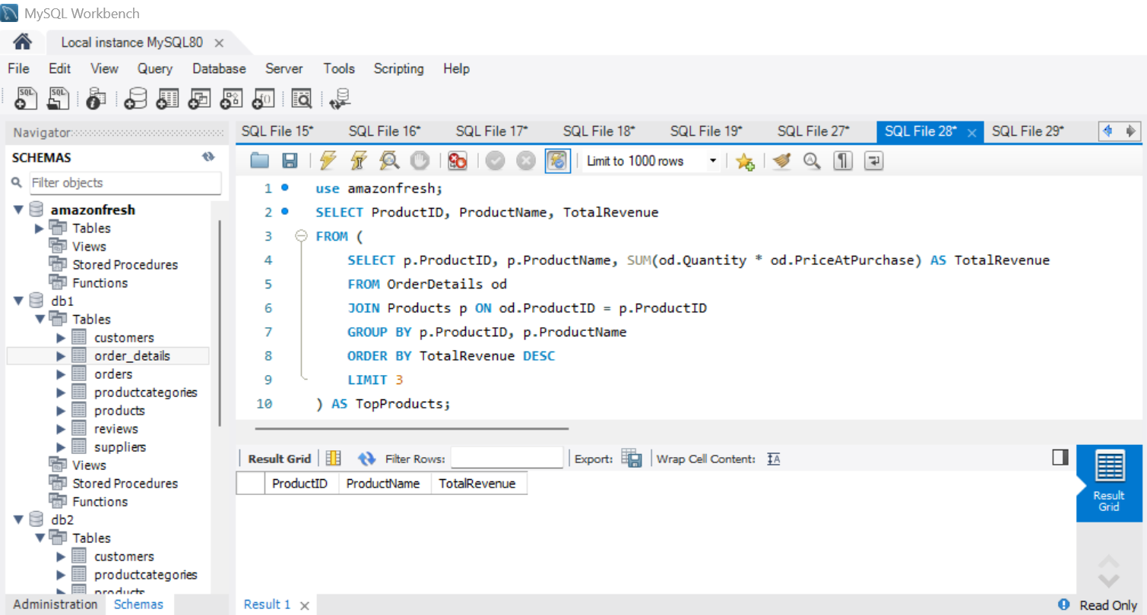
Subqueries and Nested Queries Task 13: write a subquery to: 1.identify the top 3 products based on sales revenue.
Result

Slide 27
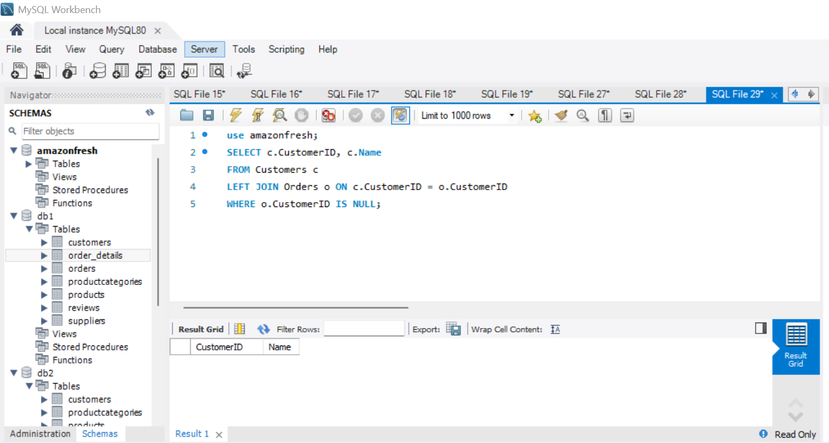
2. Find customers who haven’t placed any orders yet.
Result

Slide 28
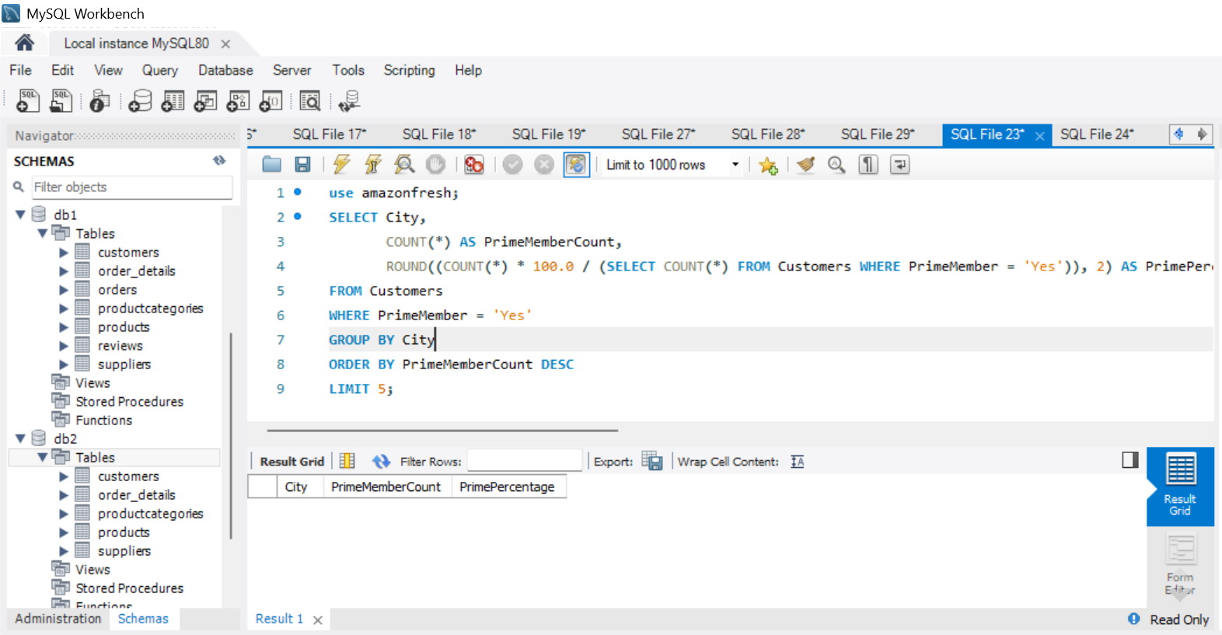
Real-World Analysis Task 14: provide actionable insights: 1.which cities have the highest concentration of prime members?
Result

Slide 29
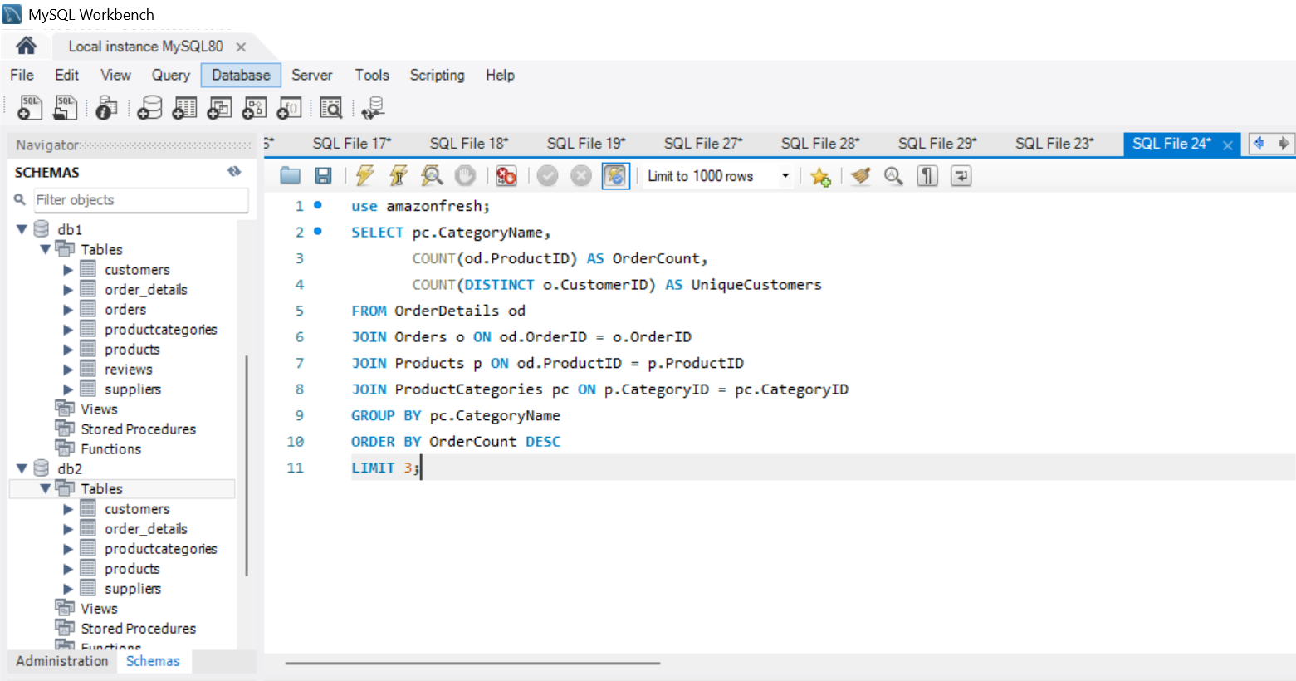
2. What are the top 3 most frequently ordered categories?
Result

Slide 30
Thank You

